Slide 1
Pitch Prediction Can we predict the next pitch?
Working with Imbalanced Data
Mark Rojas
Notes:
Understand, I live in Houston Texas and our baseball team, the Houston Astros won the world series in 2017. In that year I watched more baseball than I had in all my previous years.
----------------
Interesting to learn how much strategy is involved between pitcher and batter, anticipation of the next pitch!
----------------
PROJECT: First Capstone
----------------
Pitch Prediction –
Using Machine Learning to predict the next pitch thrown by a Major League Baseball Starting Pitcher!

Slide 2
Concerns
Major League Baseball (MLB) attendance dropped more than 6% this year, continuing a steady decline.
“It’s the lowest league-wide attendance since 2003 and the largest single-season drop in a decade.”
While some clubs saw a jump in attendance, 17 of the 30 franchises sold fewer tickets than they did last year.
Using average ticket prices from Team Marketing Report, that comes to about $93.7 million in lost ticket revenue in 2018.
- money.com
Notes:
Attendance drop >6% in 2018 – steady decline
-----------------------------
Lowest league-wide since 2003 – largest single-season drop in a decade!
-----------------------------
17-30 franchises sold fewer tickets this year
-----------------------------
On average, this comes out to $93.7 million in lost ticket revenue in 2018!!
-----------------------------
But Why??

Slide 3
But why?
High Ticket Prices
Poor Weather Conditions
Off-season Inactivity
In-game Action! ( or lack of )
Possible Reasons:

Slide 4
So what can we do?
Increased player salaries makes lowering ticket prices unsustainable.
As of today, we are still unable to control the weather.
Not every team can acquire the ‘big’ name free-agent during the off-season or win the World Series like the Houston Astros did in 2017 who recorded a $23.7 million boost in sales in 2018.
Let’s improve the in-game action!
But how?
Notes:
Increased salaries for players, expenses, scouting, etc make lowering ticket prices unsustainable
-----------------------------
Weather Control – not happening!
-----------------------------
Astros boosted sales by $23 million in 2018 after winning world series in 2017.
-----------------------------
Not every team can do this, so that leaves us with, improve in-game action!

Slide 5
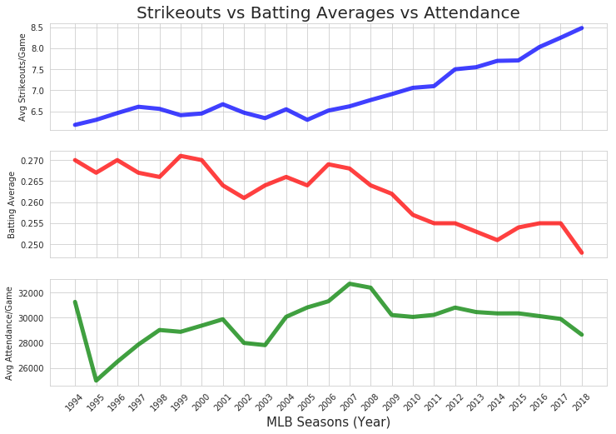
Impact on Attendance
Strikeouts | Batting Average
Average
Strikeouts per Game
Batting Averages
(Hits / At Bats)
Partial Season Lockout
Average
Attendance per Game
Down
~6.5%
Notes:
Promotions and giveaways are done all the time!
-----------------------------
Attendance as it relates to Strikeouts and Batting Averages.
-----------------------------
2005 we see an steady increase in strikeouts per game
-----------------------------
We also see batting average on a steady decline
-----------------------------
Cool part is that attendance follows the same trend as batting averages!
-----------------------------
So why would batting averages possibly impact in-game action?

Slide 6
Goal
By increasing the mean Batting Average (BA) for hitters, we:
Increase number of base runners
Increase chances for stolen bases
Increase opportunities to pick-off runners
Increase potential runs
Deliver an action-packed game!
Putting butts in the seats!

Slide 7
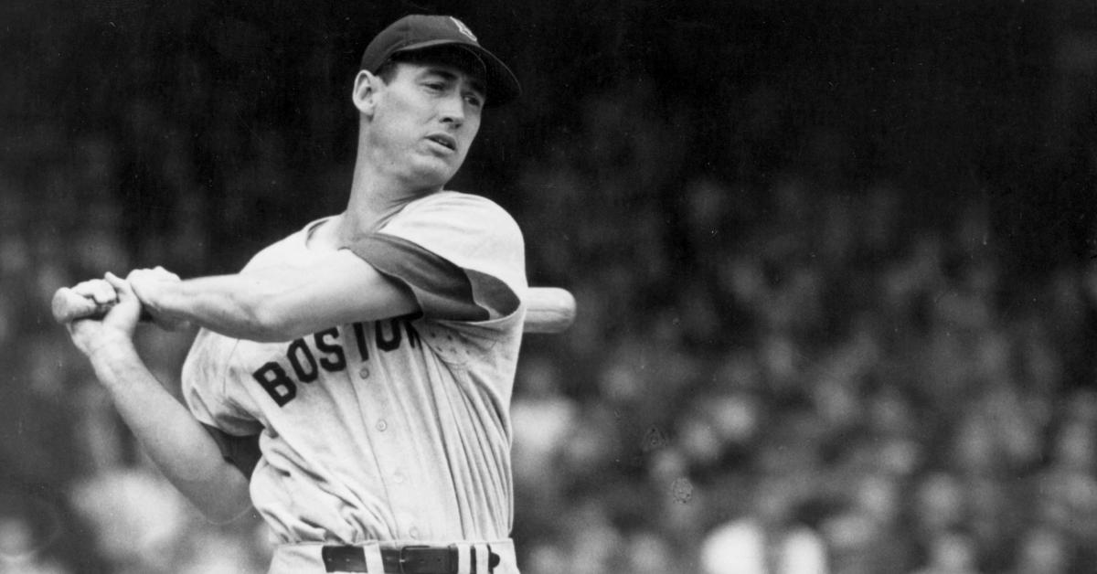
Just get more hits!
"Hitting is the single most difficult thing to do in a sport"
– Ted Williams
Notes:
So let’s have the hitters just get more hits!!!

Slide 8
Throw Hitters a Life Line
Many pitchers these days are taking steps to avoid ‘tipping’ their pitches, so it’s harder to tell what pitch is coming.
Teams found in violation of ‘sign stealing’ could be punished with forfeited draft picks and international spending money.
I propose the use of Machine Learning to predict the next-pitch and in turn improve a hitters overall Batting Average.
Notes:
Things that are already being done…
-----------------------------
Watching pitchers to ‘tip’ their pitches – tale-tale signs
-----------------------------
Sign stealing – extremely frowned upon and can lead to injury by hit pitch.
now….punishable if violated
-----------------------------
Our proposal….

Slide 9
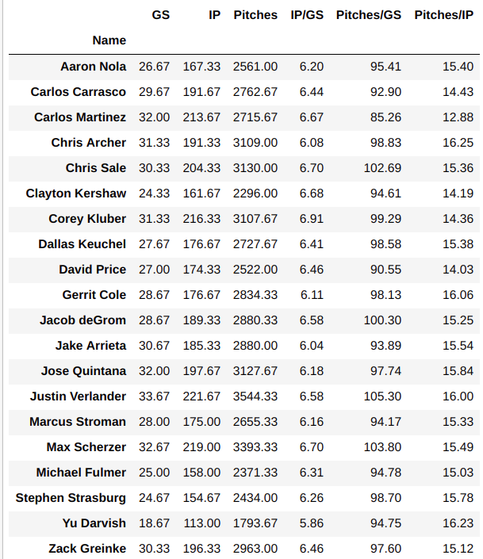
Pitchers of Interest (POI)
‘Top’ 20 pitchers of interest selected from the 2016, 2017, and 2018 seasons.
GS – Games started / season
IP – Innings pitched / season
Pitches - Pitches thrown / season
IP/GS – Innings pitched / game
Pitches/GS – Pitches thrown / game
Pitches/IP – Pitches thrown / inning
Note: The averages for these pitchers of interest are in-line with the rest of the starting pitchers in MLB.
Notes:
Selected 20 of the top pitchers from 2016-2018
-----------------------------
Describe columns for aggregated data
-----------------------------
Confirm they represent other pitchers!!

Slide 10
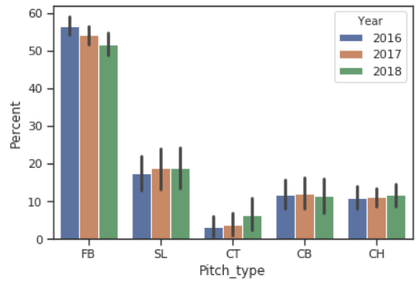
Pitch Type Consistency
Percent of Pitch Types Thrown from 2016 - 2018
We continue to see roughly the same ratios of Fastballs, Sliders, Cutters, Curveballs, and Change-ups thrown from year-to-year.
From 2016-2018, the percent of Fastballs has decreased slightly while Cutters have increased.
Notes:
Also wanted to assure that the pitch types were consistent from year to year.

Slide 11
The Dataset – Sportradar API
Past Events:
Pitch Type
Pitch Velocity
Pitch Location*
Pitch Outcome*
Pitch Sequences*
Hit Type*
Hit Zone*
Is_Bunt_Shown*
Is_Strike_Zone*
167,427 observations | 41 features for all 20 POI’s
Past Events – are those that describe the previous pitch or a result of the previous pitch.
Current Situations – are those that describe the current in-game condition.
Our Target (labeled pitch types), will be used to train our model and attempt to predict the Next Pitch Type.
Target Pitch Types:
FB = Fastball
SL = Slider
CT = Cutter
CB = Curveball
CH = Change-up
SP = Splitter
KN = Knuckleball
Current Situations:
Inning
Top / Bottom Inning*
Pitch Count
Hitter Count
Hitter Handedness*
At-Bat Count*
Number of Outs
Cumulative Pitch Type Sums
Cumulative Pitch Type %
* categorical features
Notes:
Describe ~170k Observations and 41 Features
-----------------------------
Past Event and Current Situations
-----------------------------
7 Pitch Types

Slide 12
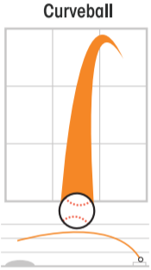
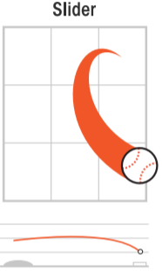
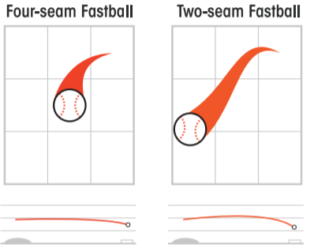
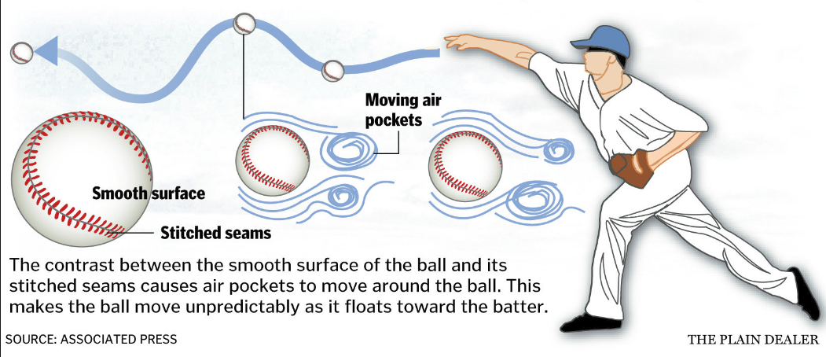
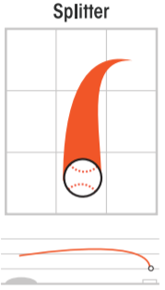
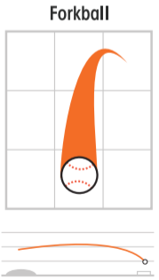
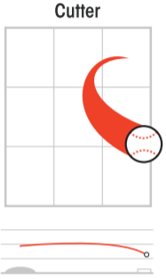
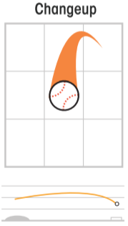
Common Pitch-Types
Breakers:
Curveball (70-80 mph)
Breaks from top to bottom
Slider (80-90 mph)
Breaks down and away from Right Handed Hitters
It is between a fastball and curve
Knuckleball
(60-70 mph)
Unpredictable pitch, movement will vary
Change-ups:
Change-up (70-85 mph)
Slower than a fastball, but thrown with the same arm motion
Fastballs:
Four-seam (85-100 mph) - Fastest, straightest pitch, little movement
Two-seam / Sinker (80-90 mph) - Moves downward
Splitter (80-90 mph) – Breaks down suddenly before reaching plate
Forkball (75-85 mph) – Like splitter but gradual downward movement
Cutter (85-95 mph) – Faster than slider, more movement than fastball
Notes:
Describe Pitch Types (SKIP IF TIME RUNNING BY)

Slide 13
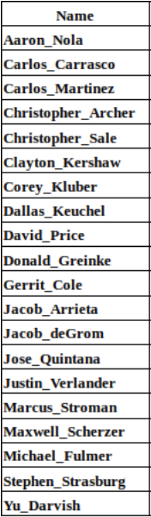
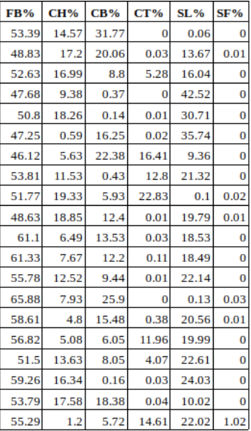
Pitchers Arsenal of Pitch Types
Percent of pitch-types each pitcher throws as part of their arsenal (2016-2018)
Class Imbalance!
Notes:
Class Imbalance

Slide 14
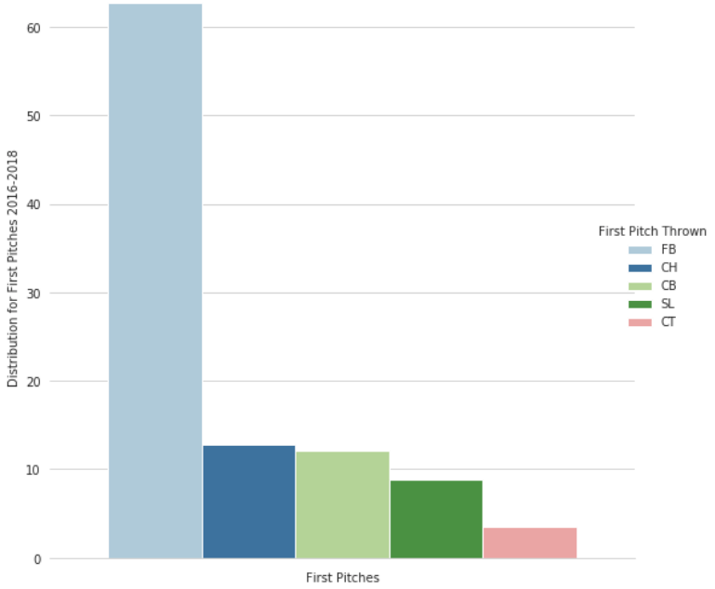
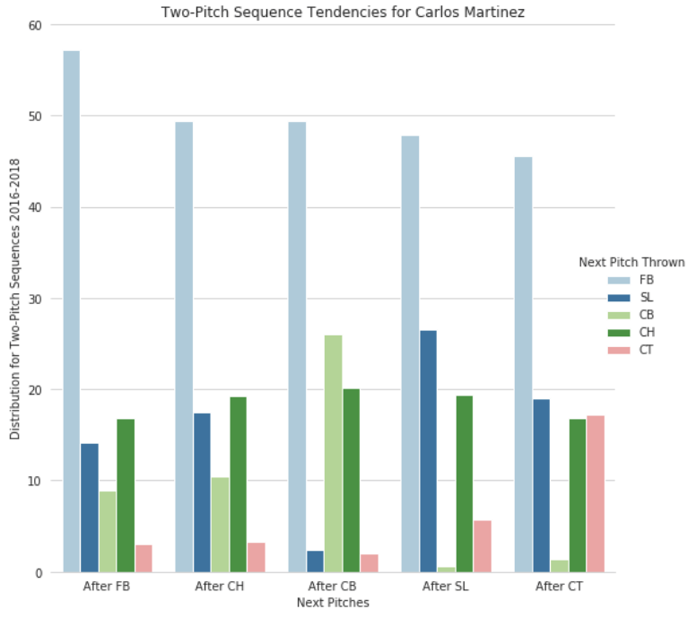
Naive Approach
First, let’s consider only the previous pitch when predicting the next pitch. There are two ways to apply the naive approach.
First pitches
Start of every inning, there is a first pitch, when there is not a previous pitch
Two-pitch sequences
Sequence of pitches consisting of previous pitch followed by the next pitch
Distribution of First Pitch and Two-Pitch Sequences for Carlos Martinez (2016-2018)
Notes:
Establish a Benchmark Performance

Slide 15
Naive Approach
Measure Performance Examples - Accuracy
In the case for Carlos Martinez, we see that we have exactly 5 classes, requiring multi-class classification.
Pitch Type | Percent Thrown
Fastball (FB) | 0.538
Cutter (CT) | 0.039
Curveball (CB) | 0.095
Slider (SL) | 0.154
Change-up (CH) | 0.174
Pitch Types and Percentage Thrown for Carlos Martinez (2016-2018)
When considering accuracy as a performance metric, the majority class is the Fastball (FB) at 0.538.
So, if we assign Fastball to all of the instances, our model would have a majority class baseline of 53.8% on this training set and our target to beat when comparing other models.
Accuracy Not Ideal!!!

Slide 16
Predictive Model Selection
Now that we know more about the data, we can select a predictive model to assess the data in a way that helps make predictions about what might happen in the future.
Labeled Data
Multiple Classes
Imbalanced Targets
Supervised Learning
Multi-class Classification
Commonly used Machine Learning Algorithms:
Logistic Regression can perform multinomial classification, applying a non-linear function (sigmoid).
Support Vector Machine maximizes the margin between the classes and the hyperplane using a loss function. However, training time can be higher than other models and less effective with noisier data.
Decision Trees are easily interpretable and non-parametric (distribution-free), managing outliers but susceptible to overfitting.

Slide 17
Predictive Model Selection
Ensemble Methods
Random Forest is an ensemble of randomized decision trees. Each decision tree gets a random sample of training data and a subset of features to base a decision on.
Gradient Tree Boosting essentially converts weak learners (i.e., decision trees) into strong learners. Not easily interpretable and sensitive to small changes in the set of features.
Ensemble Voting Classifier combines machine learning base estimators for classification via plurality voting to achieve improved generalization and robustness over a single estimator.

Slide 18
Ensemble Voting Approach
Decision: use an ensemble approach, combining multiple models with varying predictions in hopes of creating a stronger final prediction.
Performed cross-validation to pre-evaluate ‘out-of-the-box’ models.
Selected the following classifiers to use as estimators:
Logistic Regression
Support Vector Machine (with Radial Basis Function kernel)
Decision Trees
Random Forest
Gradient Boosting
Performed Grid SearchCV on each classifier for hyper-parameter tuning.
Scaled and centered numerical features based on quantile ranges.
‘Best Estimators’ used for each classifier in ensemble voting classifier.

Slide 19
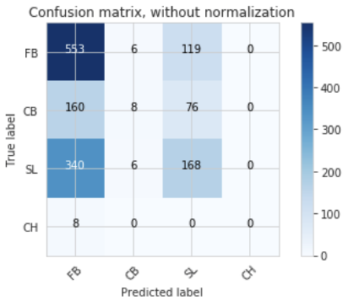
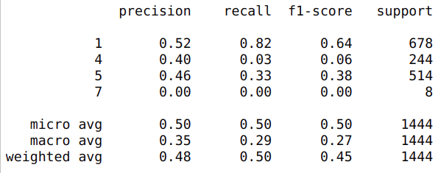
Problem with Accuracy
Classification Report for Clayton Kershaw
Accuracy = (TP+TN) / (TP+FP+FN+TN)
Pitch-type | TP | TN | FP | FN | Accuracy
Fastball (FB) | 553 | 258 | 508 | 125 | 0.562
Curveball (CB) | 8 | 1188 | 12 | 236 | 0.828
Slider (SL) | 168 | 735 | 195 | 346 | 0.625
Change-up (CH) | 0 | 1436 | 0 | 8 | 0.994
Average Accuracy
0.75

Slide 20
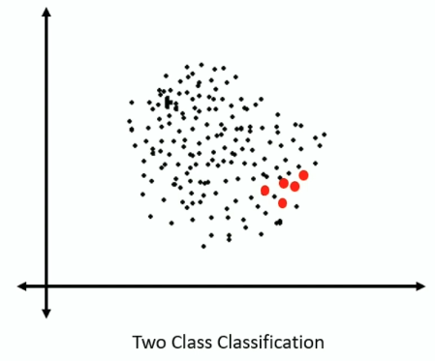
Dataset consists of a minority class
Fits on majority class
Bias and False Accuracy

Slide 21
Levels to Address Imbalance
Sample
Algorithm
Increase | Balance Data
Random Under-Sampling
Random Over-Sampling
SMOTE
Synthetic Minority Oversampling Technique
Near-Miss
Class Weights
Cost Sensitive Learning
Ensemble Approach

Slide 22
Imbalanced-learn API
SMOTE – creates synthetic (not duplicate) sample of minority class

Slide 23
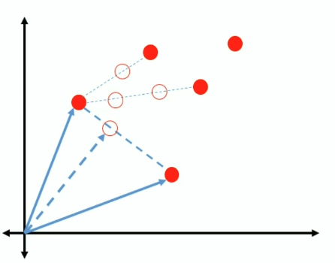
Imbalanced-learn API
SMOTE – creates synthetic (not duplicate) sample of minority class

Slide 24
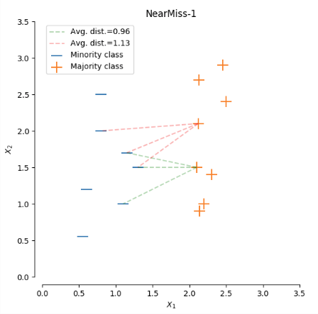
Imbalanced-learn API
NearMiss-1
selects samples of the majority class that their average distances to three closest instances of the minority class are the smallest.

Slide 25
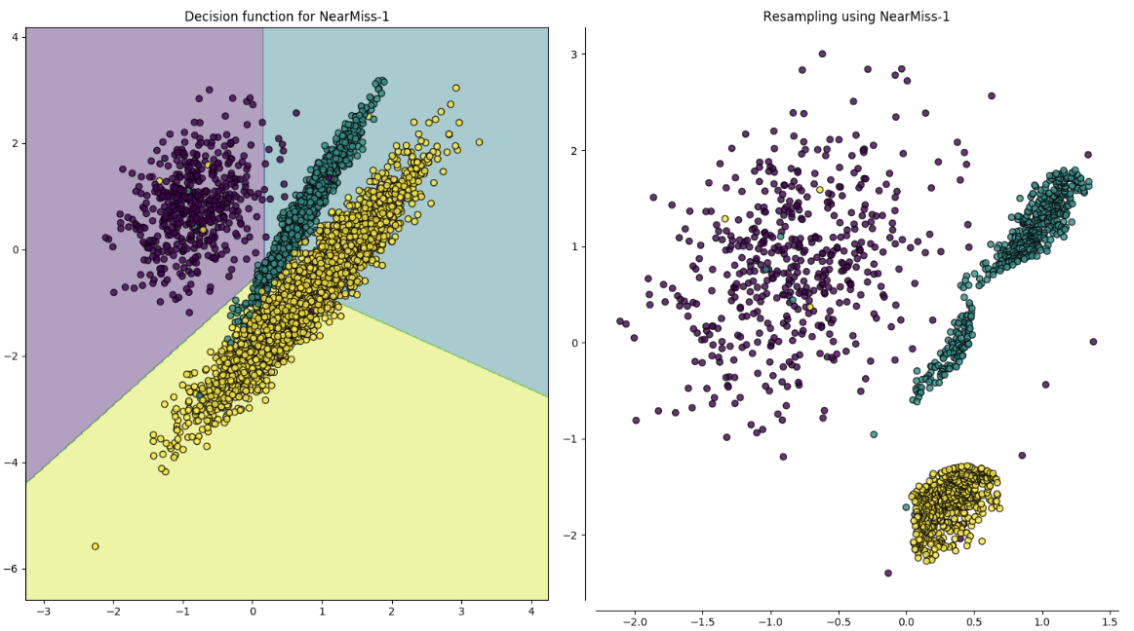

Slide 26
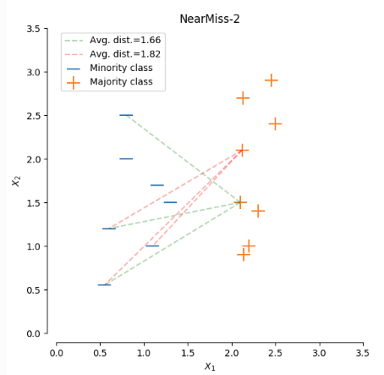
Imbalanced-learn API
NearMiss-2
uses three farthest samples of the minority class.

Slide 27
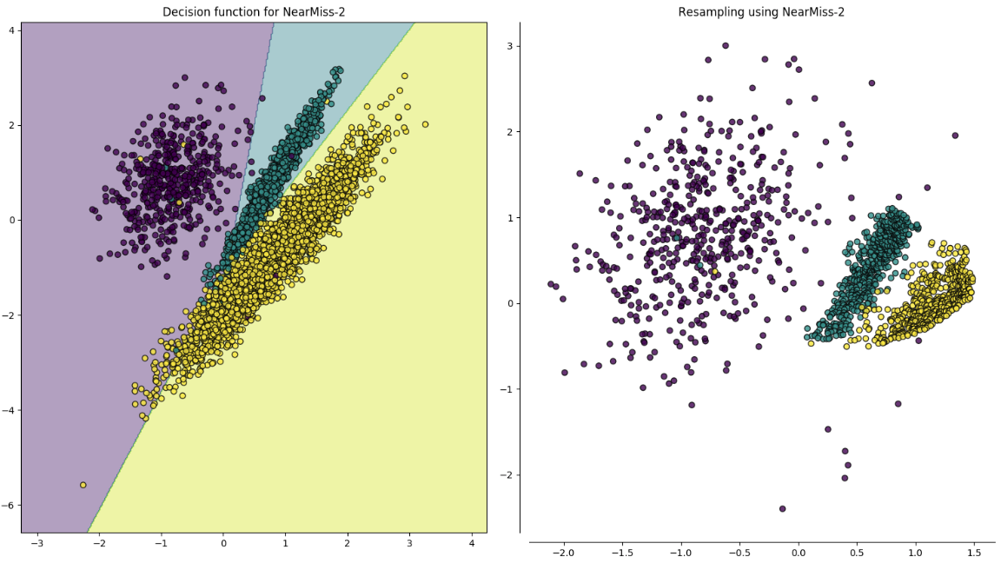

Slide 28
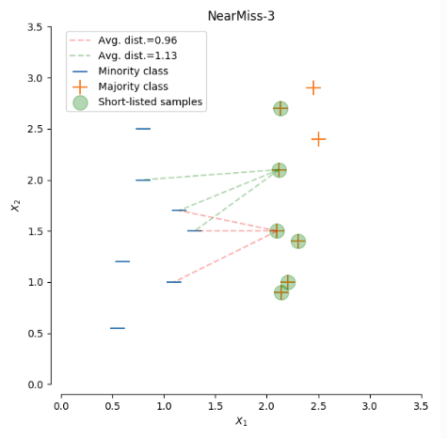
Imbalanced-learn API
NearMiss-3
selects a given number of the closest samples of the majority class for each sample of the minority class.

Slide 29
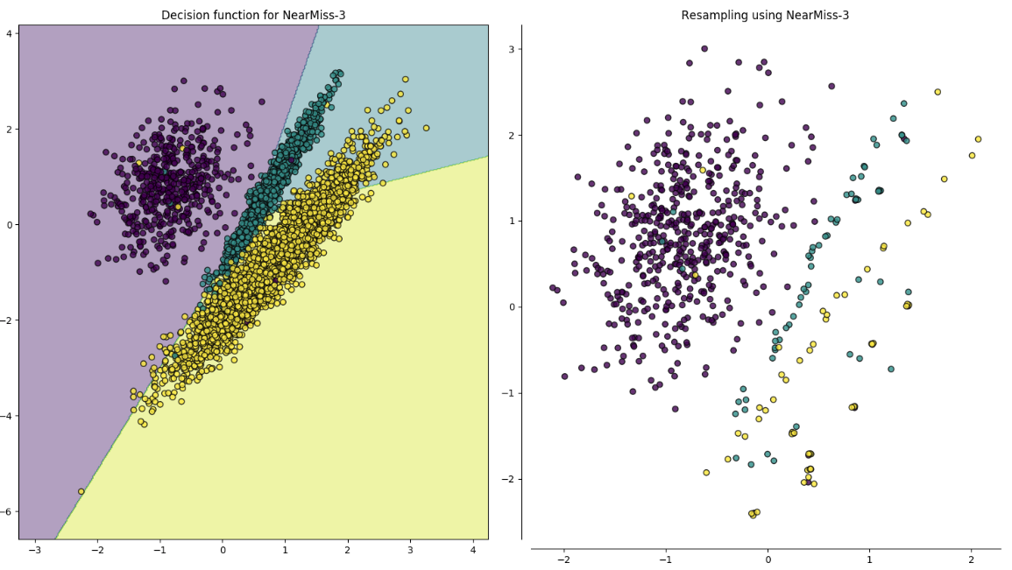

Slide 30
Levels to Address Imbalance
Sample
Algorithm
Increase | Balance Data
Random Under-Sampling
Random Over-Sampling
SMOTE
Synthetic Minority Oversampling Technique
Near-Miss
Class Weights
Cost Sensitive Learning
Ensemble Approach

Slide 31
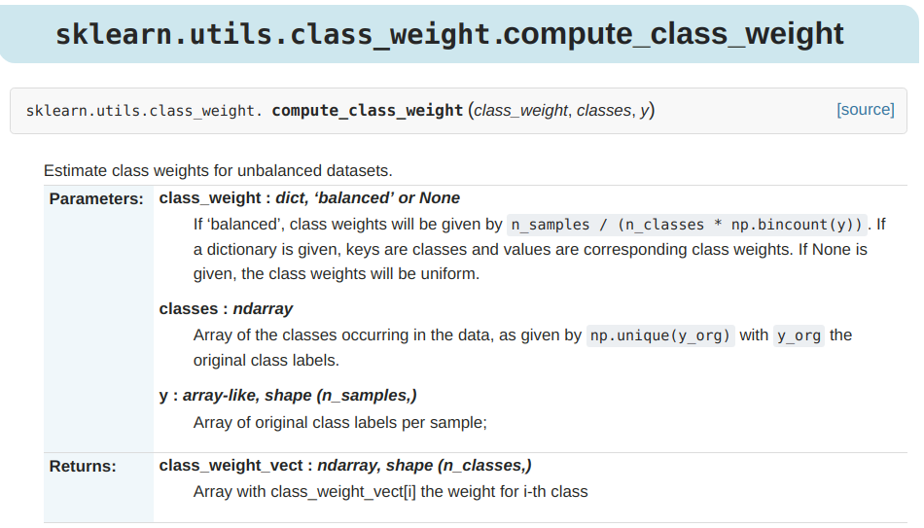

Slide 32
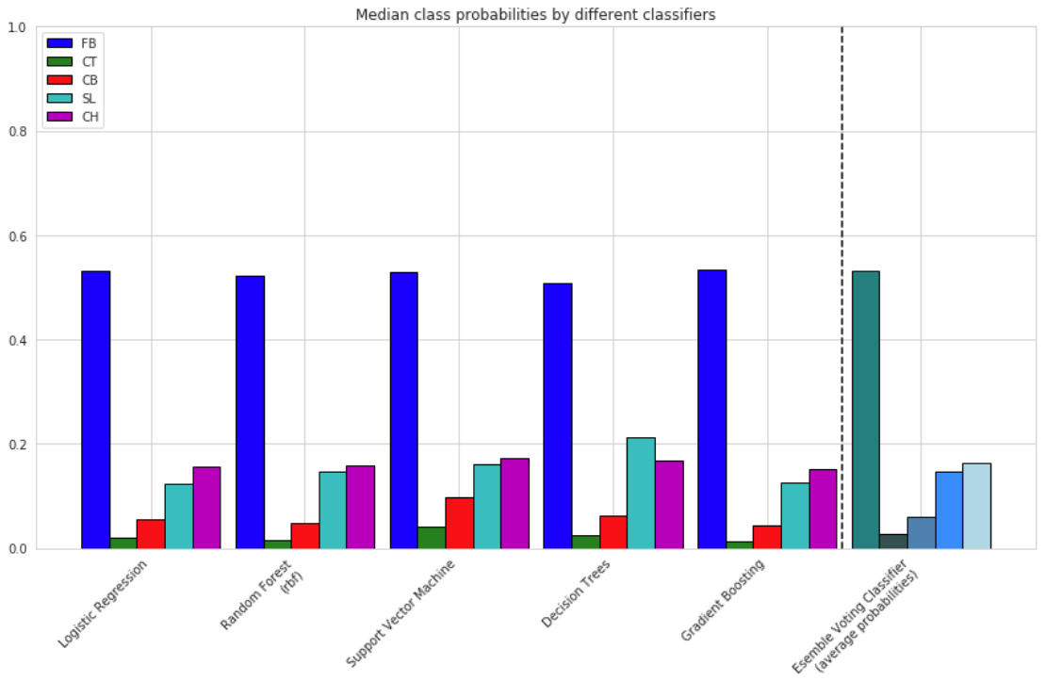
Comparing Class Probabilities
Individual Classifiers vs. Ensemble of Classifiers
Observations:
Similar median values for Fastballs and Cutters
SVM predicts slightly more Curveballs
Decision Trees predict more Sliders than Change-ups
GBM has built-in approaches to combating class imbalance
Constructs successive training sets based on incorrectly classified samples
Median Class Probabilities for each Classifier for Carlos Martinez

